Slide 1

Item | Content | Page
Improvement | Study of improvement of the storage performance by improving the corrosion resistance of zinc cans | 2
Development | Mix perlite with cathode instead of Acetylene black | 3
Deign of materials/ component parts | R6 tube battery without cap hole safety evaluation | 4
Deign of materials/ component parts | Study of Maximum insulation ring curvature for LC-NAS | 5
Benchmarking | Performance evaluation of Competitor in the Peru Market | 6

Slide 2
Technical Weekly Report | EDBD | W04 07/Jan–20/Jan/2022
2
Item/
Study of improvement of the storage performance by improving the corrosion resistance of zinc cans 【Background and Purpose】 ・After changing the lead-no added zinc can, the long-term storage performance at room temperature tend to deteriorate. ・In particular, PECSH batteries using lead-no added zinc materials from other company have been complaining about performance degradation at an early stage. ・In W49, we reported that zinc can corrosion during storage was suppressed by increasing the amount of zinc oxide to MIX, but the discharge performance was reduced. ・This time, we report the results of changing the electrolyte formulation for the purpose of improving the initial discharge performance (particularly high drain Discharge performance) that was reduced by increasing the amount of zinc oxide. 【Contents】 -Mix prescription : EMD100% M/C=6 Zinc oxide added 1.5-3.0% (EMD ratio) -Electrolyte spec : No.130(Current), No.125(Panabras), No.120(New) -Zinc cans : PECIN lead-no added zinc cans (in-house zinc cans) -Discharge mode : IEC mode Initial discharge 【Results】 ・From the results of the initial discharge performance, when the amount of zinc oxide was increased (1.5% ⇒ 3.0%) and the current No. 130 electrolytewas used, the initial discharge performance PI showed a tendency to decrease by 6 points. ・In particular, 3.9Ω continuous and 3.9Ω LIF tended to decrease. ・However, when No.125 and No.120 electrolytes were used, the discharge performance of 3.9Ω and 3.9LIF tended to improve. ・In particular, the No.125 electrolyte tended to improve. (No.125 is currently used in Panabras) ⇒ Ammonium chloride in No.120 and No.125 electrolyte is larger than that in No.130 electrolyte. It is known that the discharge reactivity of the positive electrode is improved by increasing the amount of ammonium chloride.
Fig1. Impact of increased zinc oxide and discharge
performance depending on the type of electrolyte

Slide 3
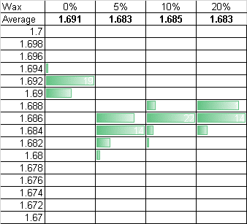
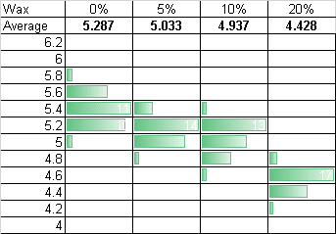
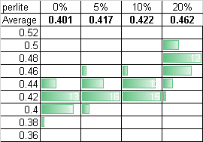
Technical Weekly Report | EDBD | W04 07/Jan–20/Jan/2022
3
Item/
【Title】 Mix perlite with cathode instead of Acetylene black 【Back ground】 ・In 2021 the price of acetylene black for cathode mix Rapidly Increase. We need to reduce the amount acetylene black for profit. ・I try to test Perlite which it have electrolyte absorption instead of acetylene black. But the main component of it is SiO2 and Al2O3. So it has low electrical conductivity. ・To reduce the amount of acetylene black I try to test the New cathode mix it is replaced partial acetylene black to it. 【Material】 Name : Perlite Image : Milled powder Main composition SiO2(72.7%), Al2O3(16.5%) Material cost : 880 USD/MT *Jiaozuo acetylene black : 4350USD/MT 【Evaluation】 Evaluate battery performance for the mix with Perlite. Battery type : R6 tube made in PECIN EMD : Zhongxin AB : Jiaozuo Electrolyte : No. 130 (LC-200 500ppm) M/C = 6.0 I replace parts of acetylene black with Perlite. | 【Results】 ・Larger perlite ratio mix cathode have, static characteristic change lower SCC and higher IR . ・Discharge performance of the battery with perlite is similar as reference battery with only acetylene black. Fig.1 Static characteristic ○OCV ○SCC ○IR Table.2 Discharge performance
Perlite Ratio | Resistance(Ω) | 3.9 | 3.9 | 3.9 | 100mA | 50mA | 43 | PI
 | mode | Scont.M | LIF | 1H/D | 1H/D | 1H/8H, 24H/D | 4H/D
 | End point(V) | 0.9 | 0.9 | 0.8 | 0.9 | 1.0 | 0.9
 | unit | min | min | hour | hour | hour | hour
0% | Duration | 97.0 | 165.9 | 2.5 | 8.5 | 19.9 | 35.3 | 152
 | Index | 100 | 100 | 100 | 100 | 100 | 100
5% | Duration | 100.3 | 166.9 | 2.5 | 8.2 | 19.7 | 35.3 | 152
 | Index | 103 | 101 | 100 | 96 | 99 | 100
10% | Duration | 100.0 | 163.4 | 2.5 | 8.2 | 19.7 | 35.2 | 151
 | Index | 103 | 98 | 100 | 96 | 99 | 100
20% | Duration | 100.4 | 168.1 | 2.5 | 8.3 | 19.6 | 35.1 | 152
 | Index | 103 | 101 | 100 | 98 | 98 | 99
Acetylene Black(%) | 100 | 95 | 90 | 80
Parlite(%) | 0 | 5 | 10 | 20

Slide 4

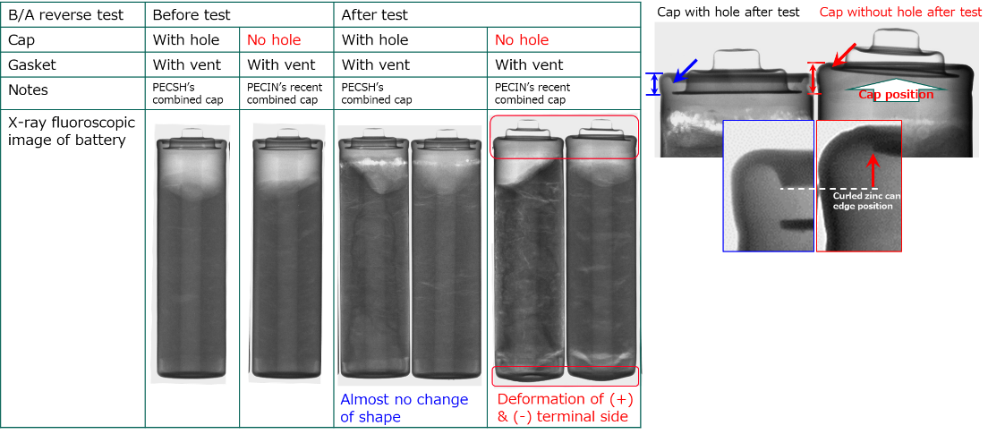
Technical Weekly Report | EDBD | W04 07/Jan–20/Jan/2022
4
Item/
R6 tube battery without cap hole safety evaluation [Back ground & Objective] In current tube type battery of Panasonic, every battery has vent on gasket and hole on cap to release gas to outside. Recently, PECIN asked us about possibility of removing hole on cap. This time, we evaluated the effect of hole on safety. [Sample] 1) R6 tube battery with cap hole 2) R6 tube battery without cap hole [Evaluation] ¼ reverse test , X-ray fluoroscopy [Result] As a result of trial in PECIN, they observed No explosion od the battery without cap hole. So we made trial battery in our Lab. and evaluated the effect of hole on safety. Table 1 shows the results. As a result of the test, No explosion was observed in both samples with and without cap holes. On the other hand, we found that total height of the battery without cap hole increased by 2 mm. Table 2 shows result of X-ray fluoroscopy. As a result of the analysis, shape of the battery with cap hole was not changed. However, following point were observed in the battery without cap hole. Cap was protruded condition Zinc can bottom was also protruded condition Distance between zinc can grooving position and shoulder of zinc can was increased Position of curled zinc can edge was changed and sealing shape was loosed From above results, we confirmed that sealing condition (Zinc can curling) of the battery without cap hole was loosed. And this condition has a risk on safety. We will analyze detailed mechanism of how the gas is released to outside from the battery without cap hole .
Table 1 Initial discharge performance
Trial battery |  | EDBD Lab. R6 tube battery Gasket with vent EMD100% & M/C=6 prescription
Booster battery |  | PECGI R6 NWC (EMD100%, M/C=6)
 |  |  | Cap
 |  |  | With hole | Without hole
 |  | Explosion* | 0/3 | 0/3
 |  | Cap protrusion | 0/3 | 0/3
 |  | Increasing T.H. | 0/3 | 3/3
 |  | Leakage | 2/3 | 2/3
 |  | Δ T.H. after | 0.0 | 2.3
 |  | safety test | 0.1 | 1.2
 |  | (mm) | 0.1 | 2.6
 |  | Ave. | 0.1 | 2.0
 |  | Δ S.H. after | 0.3 | 0.8
 |  | safety test | 0.3 | 0.4
 |  | (mm) | 0.0 | 1.0
 |  | Ave. | 0.2 | 0.7
Table 2 Static characteristics

Slide 5
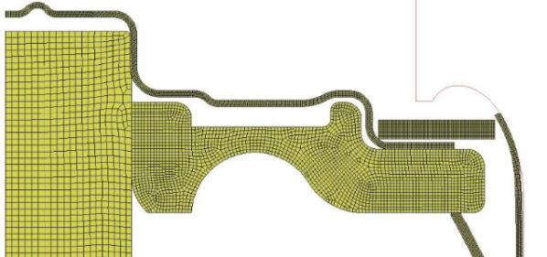
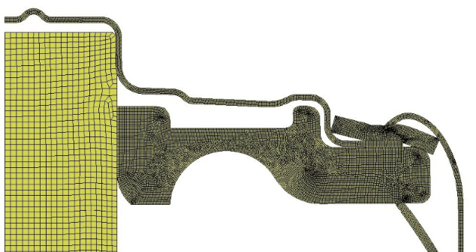
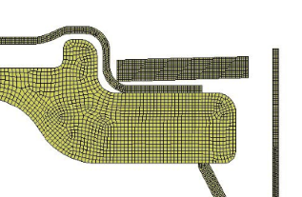
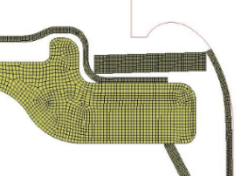
Technical Weekly Report | EDBD | W04 07/Jan–20/Jan/2022
5
Item/.
Maximum insulation ring curvature for LC-NAS [Back ground ＆ Objective] Process defect about insulation ring insertion is a lot in PCA. Insulation ring has curvature due to decreasing its strength that may be caused by increasing the material recycle ratio for VE. [Evaluation] We simulated the insulation ring that has curvature 0.1mm on 0.6mm thickness. Cap setting height maximum is 62.1±0.2mm from Panabras and PCA process spec. [Result] In case of curved insulation ring t0.6mm+0.1mm, tip of metal jacket crashed with insulation ring during metal jacket crimping. [Consideration] The spec. of insulation ring thickness is 0.6±0.05mm. If the insulation ring height at outer perimeter exceeds 0.70mm, it is not approved due to crimping error by the crash. Therefore we think the maximum insulation ring height is 0.7mm max which has curvature and burr. But the insulation ring thickness itself is 0.6±0.05mm. [Future activity] The factor of process defect is within insulation ring supply process. However we can add the maximum by flatness and parallelism tolerance on insulation ring drawing. The flatness tolerance is 0.05mm and the parallelism tolerance is 0.05mm. This is derived from thickness tolerance±0.05mm mathematically. These tolerances of IR thickness, flatness and parallelism make IR height 0.7maximum. If IR height is bellow 0.7mm, crimping was succeeded. We will continue to investigate or search the process design or some rules.
<IR thickness 0.6mm(0.6mm=spec. center)>
Cap setting
height max.
62.3mm
IR Outer Φ:31mm
IR Inner Φ:23.6mm
0.6mm
Cap setting height spec.:
62.1±0.2mm(Ref.Panabras, PCA)
IR spec. (Ref: PECTH)
Thickness : 0.6±0.05mm
Outer Φ : 31±0.1mm
Inner Φ : 23.5＋0.2/-0mm
Crimping was succeeded
<IR height 0.6+0.1mm (+0.1mm=warp)>
Crash tip of MJ with IR
0.6+0.1mm

Slide 6
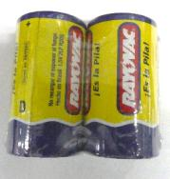
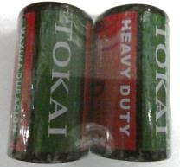
Technical Weekly Report | EDBD | W04 07/Jan–20/Jan/2022
6
Item/
【Background】 In order to expand sales in the Latin American market, we conducted research on the trends of other companies and evaluated the performance of other companies' batteries. 【Purpose】 Performance evaluation of other companies in the Peru Market 【Item】 R20:ROV/Brazil, Tokai/China Test : Discharge performance (Initial, 45-3M) Heavy metal content 【Result】 When the ROV battery is stored at 45 °C for 3 months and then subjected to a discharge test, the probability of abnormal discharge in flashlight mode is high. The TOKAI battery can be used without any problems. Both ROV and TOKAI are not environmentally friendly because Pb is added. See the next chart.

